Slide 1
MARC 040 Manage Fuel Systems

Slide 2
Introduction
Now we will look at
Planning refuelling
Refuelling precautions
Tank and system requirements and layouts
Tank arrangements
Types and sources of pollution
Required Documents
Reporting Spills
Penalties

Slide 3
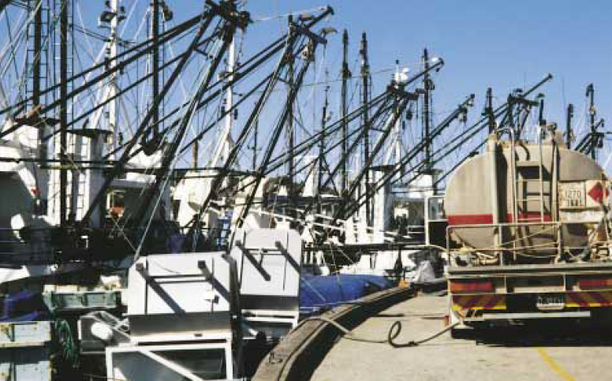
REFUELLING PRECAUTIONS
What is wrong in the picture ?

Slide 4
REFUELLING PLANNING
Dip all fuel tanks to establish the current amount of fuel already on board.
Calculate the amount of fuel required to bring tanks to required levels.
Order required grade and amount of fuel following company procedures/SMS
Calculate the impact of the refuelling operation on vessel safety and the effect on the vessels stability
Consult with Port Authority if required on an agreeable time and place if refuelling ship to ship or suitable wharf if tanker to ship and time if fuel wharf as to the expected time frames start to finish.
Make up Ullage report/or Bunker plan on all tanks in preparation for refuelling as this can save considerable time and paperwork

Slide 5
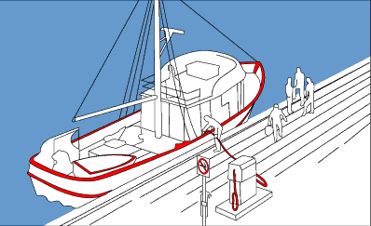


REFUELLING PREPERATION
Secure vessel properly alongside
Hoist Bravo flag
Motors off vents closed, intake fans off
Gas off no naked lights no hot work
No smoking signs out
Have fire extinguishers ready on deck
Portable tanks out of vessel to fill
Block deck scuppers and put containers under tank vents
Have spill kit close at hand
Provide earth connection
Sound tanks and record ullage

Slide 6
REFUELLING PRECAUTIONS
Get out and follow procedure from SMS and use the refueling check list to document compliance.
Establish Communications with shore staff and set up exclusion zone
Inform port authority of fuel transfer operations before commencing.
Check condition of all hoses, connectors and test date of hoses
Secure fuel hoses and lock wire connections on large hoses to prevent hoses becoming uncoupled
Keep fuel nozzle in contact with filler pipe on small hoses
Select valves to direct fuel to correct tank and when flow starts check breathers to ensure fuel is going to correct tank

Slide 7
REFUELLING PRECAUTIONS
Maintain constant watch on fuel flow and monitor fill rate and tank level
Consider stability when filling wing tanks
Take fuel samples during filling process label and stow as part of fuel quality monitoring if quality looks poor stop refueling and investigate.
Slow fill rate as tanks approach max fill level
On completion of fuel bunkering drain hoses before disconnecting by walking the fuel out or blowing the hoses through

Slide 8
REFUELLING PRECAUTIONS
Cap off and remove hoses from vessel or if vessels hoses stow them away.
Obtain bunker receipt for records
Obtain fuel sulpher report and analysis for records
Enter refueling amount in ships log
Make up oil record book
Close of refueling check lists and file away
Ventilate vessel before startup

Slide 9
Refuelling Emergency's
Broken mooring lines allowing vessel to swing out. Stop flow and resecure vessel, check all hose connections before recommencing bunkering
Hose leaks, stop the flow and fix or replace hose.
Fire and explosions, raise the alarm and stop the flow, check for casualties, inform authorities, fire control, remove hoses from deck if possible, prepare to abandon ship if you lose control, possibility of fire spreading from ship, radio for assistance urgently.

Slide 10
Refuelling Emergency's
Transfer pressure to high, ask for reduction in flow rate and pressure.
Fuel going to wrong tanks, open valve to correct tank and then close off wrong tank never close of valves from delivery manifold as supply hose may burst always consult bunker control staff before closing any valves
Stop the flow immediately, if in any doubt.
Incident report for any fire/explosion POLREP for any spill enter details in ships log

Slide 11
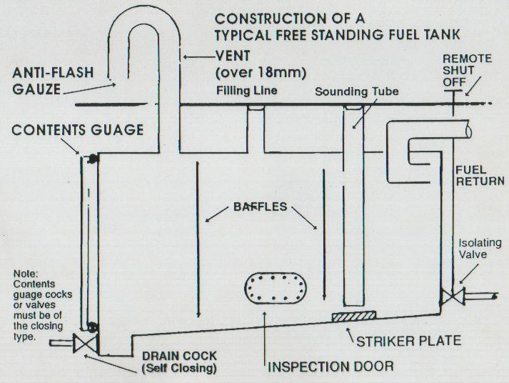
Legislation Fuel Tanks Requirements
Vented to atmosphere
Gooseneck Breather
Flame trap in breather
if vent greater than
18mm diameter
Filler outside of vessel
Remote Fuel Shut-off
Drain (sludge) cock
Sounding Pipe (or Sight
Gauge w/- self closing
Cocks)
Inspection Plate (manhole)
Baffles
Know how to sketch above fuel tank, including remote shut-off valves

Slide 12
Fuel Systems - Requirements
System Includes
Storage & service tanks
Edge
Primary
Filters
Magnetic
Secondary
Transfer
Lift
Centrifuge
Pumps
Charge
Injector
Injectors

Slide 13
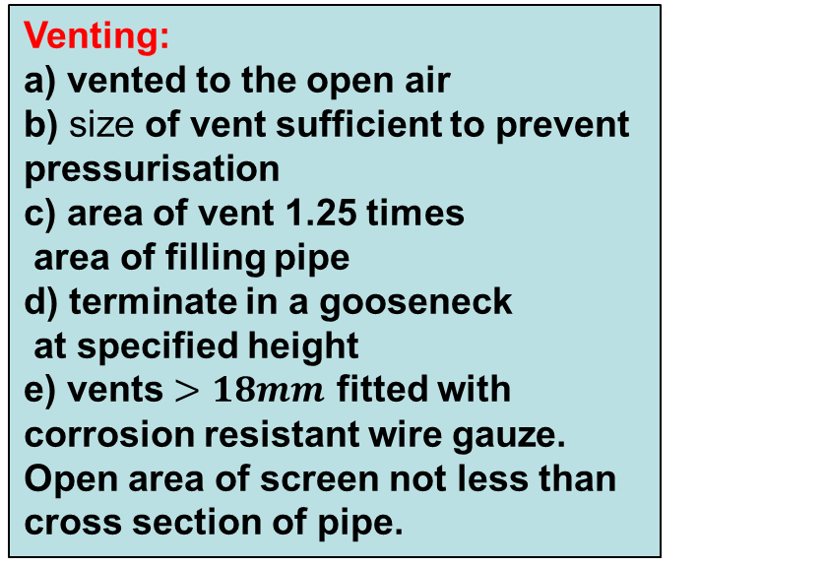

Fuel Systems - Requirements
Fuel system for vessels less than 35m in measured length must meet
requirements as per NSCV (National standards for Commercial Vessels)
Part C Section 5 subsection 5A Chapter 4
Non – portable Fuel Tanks
Location - not to be fitted:
over stairways
over hot surfaces
over electrical equipment
any location where spills
can contact hot surfaces
e) Must be metal construction

Slide 14
Fuel Systems - Requirements
Fuel system for vessels less than 35m in measured length must meet
requirements as per NSCV (National standards for Commercial Vessels)
Non – portable Fuel Tanks
Fuel Shut-off:
a) a fuel shut-off valve or cock
fitted in each tank outlet line (all fittings & pipes
between tank & shut-off valve/cock to be metal
b) external means provided for operating shut- off
valve or cock
Filling Pipes: shall have permanent filling pipe extending from open deck to tank and fitted with a bund.
Baffles: shall be fitted to reduce the effects of surging of tank contents. To be fitted at intervals not more than 1 m along longitudinal or transverse axis of tank
Filling Station:
Located outside machinery spaces.
Arranged to prevent overflow contact
with hot surfaces
c) Arranged to prevent overflow causing
possible pollution A Bund fitted.

Slide 15

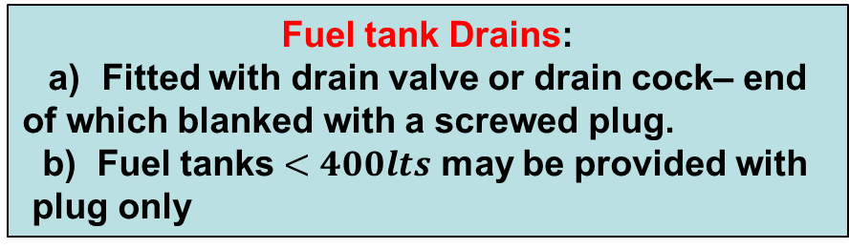
Fuel Systems - Requirements
Fuel system for vessels less than 35m in measured length must meet
requirements as per NSCV (National standards for Commercial Vessels)
Non – portable Fuel Tanks
Fuel tank contents measurements:
Level indicating gauge glasses to be
fitted with self-closing valves/cocks.
Only 1 such valve/cock needed if
upper end of gauge is connected to
top plate of tank
Sounding pipes should not be located in
Accommodation spaces
Fuel Pipes: shall be of seamless, heavy gauge metal, connected by visible minimum number of flanged, metal to metal, or conical type joints.
Where cone nipples are used they shall be welded. Olive-type fittings shall not be used.
Flexible fuel piping may be used: a) between fuel shut-off valve & engine
b) Engine fuel return back to tank pipe work. Must be as short as possible

Slide 16
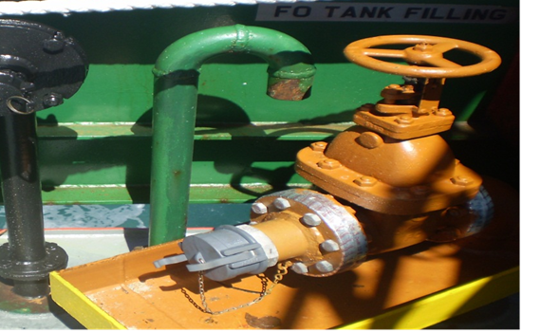
Legislation Fuel Tanks Requirements
Refuelling manifold inlet
Note the safety cap
Bund to stop spill
Tape on joints to alert the
presence of leaks
Colour coding of pipes and
vents to prevent confusion
Valve identification label

Slide 17
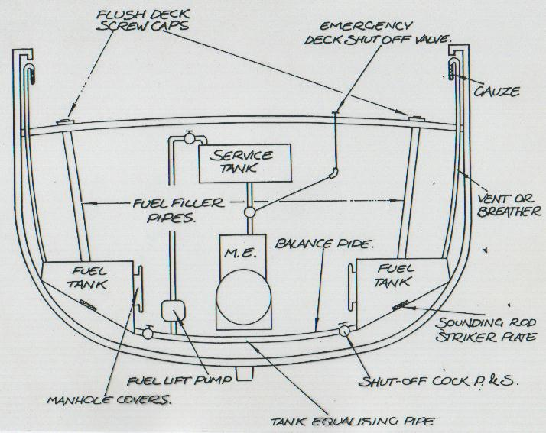
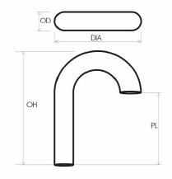
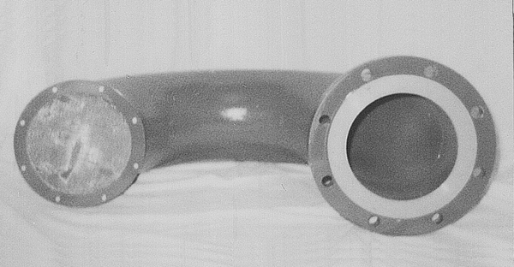
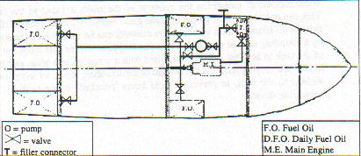
FUEL SYSTEM Typical Layout
*Fuel tanks must be vented to atmosphere and fitted
with anti-flash gauze

Slide 18
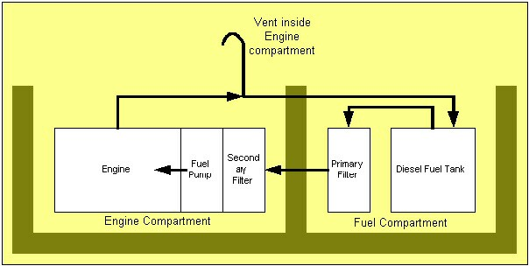
Typical Diesel Fuel System
❺
❹
❸
❷
❶

Slide 19
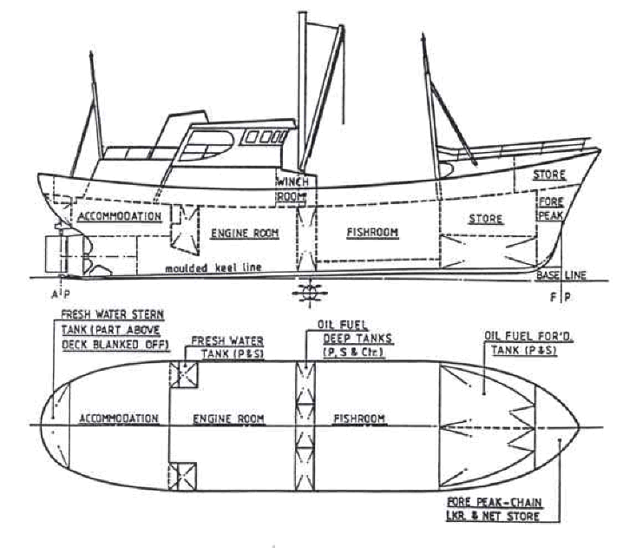
TANK ARRANGEMENTS
Two Purposes-
Store liquids
Provide 2nd skin when
part of hull
Storage for-
Fuel
Lubricating Oil
Ballast Water
Fresh Water
Sewage
Oily Bilge Water
Cargo

Slide 20
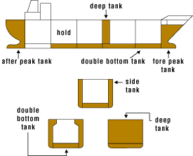

Slide 21
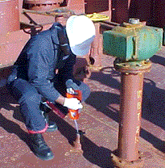
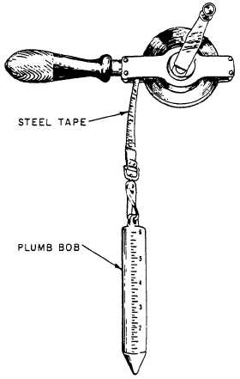
Filling sounding venting
SOUNDING TANKS
Tapes , sounding rods, sight glasses, electric gauges, pressure gauges

Slide 22
POLLUTION
Navigation Act 2012 and Domestic law of 2012 and the marine orders 90 through 99 adopt the “MARPOL” (International Convention for the Prevention of Pollution from Ships 1973/1978)
Queensland's “Transport Operations Maritime Pollution Act” and Regulation incorporates both of the above and specifies HOW and WHERE a pollutant can be disposed of. TOMPA, TOMPR
The NSCV/USL, MARPOL, TOMPA TOMPR codes specifies measures to control pollution required on vessels and the management systems that must be in place on all vessels.

Slide 23
POLLUTION
Any water containing more than 15 parts per million of oil is a pollution ( if you see a film on the water you have broken the law)
Its not a POLREP spill if it all stays on the deck and is cleaned up appropriately.
If it hits the water it’s a reportable spill. If you spill 20 litres its reportable and you will complete a POLREP report.

Slide 24
MARINE POLLUTION RECORDS
Vessel operators are required to keep records of all waste disposal.
Oil Record book updated every week.
Records of Chemicals and Dangerous goods kept on board including oils and fuels.
Rick Assessment of pollution risks.
MSDS sheets for all fuels , oils and chemicals on board.

Slide 25

Pollution Reporting
Complete a pollution report for any spills over 20 litres made or sighted
Use the POLREP report
Send to ASAR, AMSA, Local Harbor Authority
POLREP report CLICK IMAGE

Slide 26

MARINE POLLUTION
PENALTIES
Failure to comply with Australian Federal, State legislation and MARPOL 73/78 legislation can result in penalties of up to $220,000 for an Individual, or $1,200,000 for Companies in fines and prosecutions for each offence

Slide 27
Marine Engineering Calculations
MARC 040

Slide 28
Legislation
We have to maintain adequate records of maintenance and engineering calculations as per legislation for our ship, Items Like fuel and oils on board, sewage, garbage, all have requirements for accurate records to be maintained.
Engine room logs must be maintained , service work records kept and Survey records filed.
Service periods and times recorded.
Fuel logs, fuel consumption, KW hr per litre comparison figures, ballast calculations and logs.
Records can be electronic or paper in line with company procedures and ships SMS system.

Slide 29
Legislation
Reports must be made and filed as per ships SMS and in line with legal requirements.
Full lists of requirements can be accessed in the following codes and legislation.
*NSCV/ USL - Class society , Construction, Maintenance, & Safe operation
*Maritime Legislation – Transport Operations Maritime Safety, Maritime Safety Queensland, Marine Orders, & OHS
SEVERE PENALTYS APPLY FOR NON COMPLIANCE IF DEATH OR INJURY RESULTS FROM FAILURE TO REPORT FAULTS

Slide 30
Common base measurements in marine engineering:
METRES are the measuring scale for DISTANCE (LENGTH)
TONNES are the measurement for MASS
SECONDS are the measurement for TIME
TEMPERATURE is measured in CENTIGRADE
DENSITY is the measurement of a subject’s MASS per unit of VOLUME
NEWTON'S are the measurement for FORCE
One Newton of force is required to accelerate a Mass of one kilogram by one metre per second per second.
PASCAL'S OR PSI are the measurement for PRESSURE
JOULES are the measuring for ENERGY
WATTS are the measurement for POWER
METRES / SECOND is a measurement for SPEED
METRES / SECOND in a specific direction measures VELOCITY
TORQUE is measured in NEWTON/METRES

Slide 31
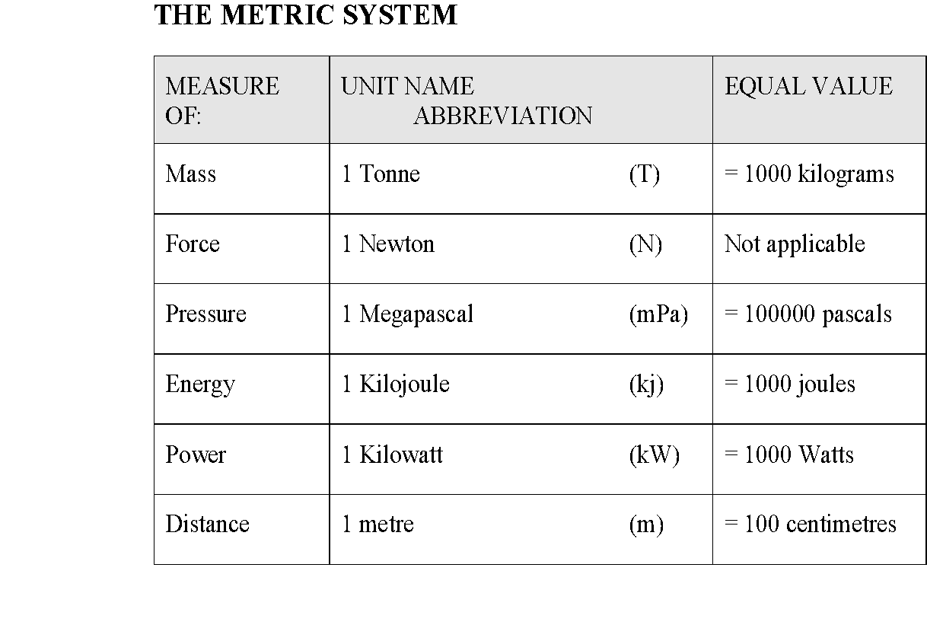

Slide 32
Common Used units and equivalents
1 Horse power = 750 watts or .75 KW
0 degrees centigrade = 32 degrees Fahrenheit
100 degrees Centigrade = 212 degrees Fahrenheit
1 degree C = (1 x 1.8 + 32) 33.8 degrees Fahrenheit
1 Pound per square inch = 6.894 KPA
1 Kilo Gram = 9.80 Newtons
1 Bar ( 1 atmosphere) (14.503 PSI) = 0.1 Mpa
1 Bar = 100 Kilo Pascals Kpa
10.129 meters head of fresh water = 14.7 psi or 1 bar
10 meters head of salt water = 1 Bar or 14.503 psi
1 meter cubed = 1000 litters

Slide 33
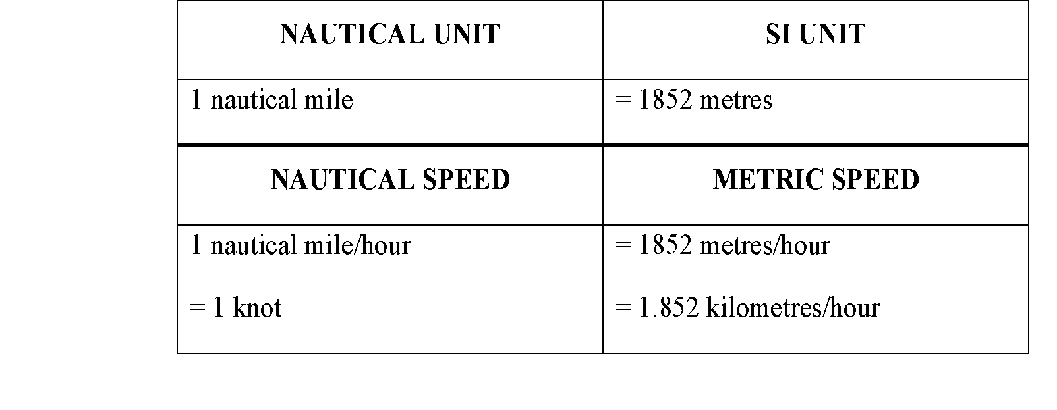
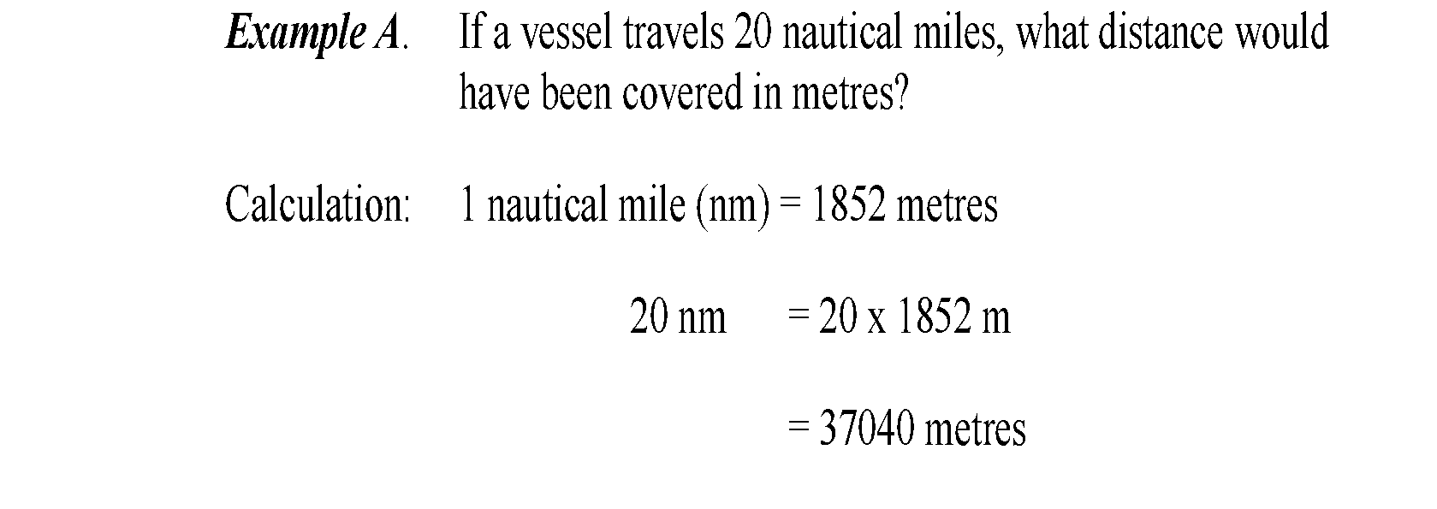

Slide 34
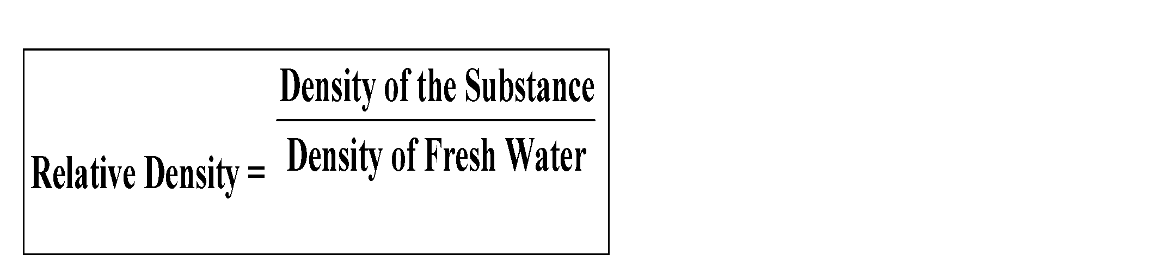
Converting Quantity and Volume to Mass using Relative Density
THE RELATIVE DENSITY, also known as the SPECIFIC GRAVITY, of a substance as a ratio measurement comparing the mass of a volume of one substance to the mass of an equal volume of fresh/pure water.
1m3 = 1000 Litres Fluid Capacity
STANDARD FRESH WATER: SG = 1.00
1m3 = 1 Tonne = 1000 Kilograms
THEREFORE:
1000 Litres = 1000 Kilograms 1 Litre = 1 Kilogram

Slide 35
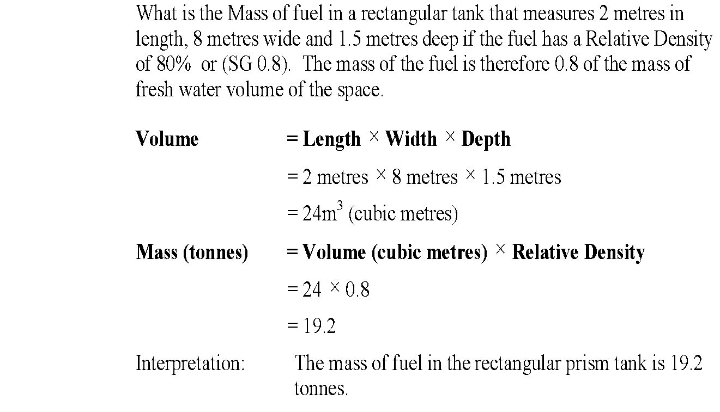
Relative Density
In this formula Density of the substance can be replaced by Relative Density of a substance as defined earlier in this section (since density of fresh water = 1) = SG1.

Slide 36
Calculating Areas and Volumes
To find an AREA of a rectangle we multiply length by width = Area and is expressed as a number squared
To find the AREA of a triangle we multiply the base by half of the Width.
To find the AREA of a circle we multiply the radius by the radius and then by Pie (3.142) to get the area
VOLUME is found by multiplying the AREA by the height.

Slide 37
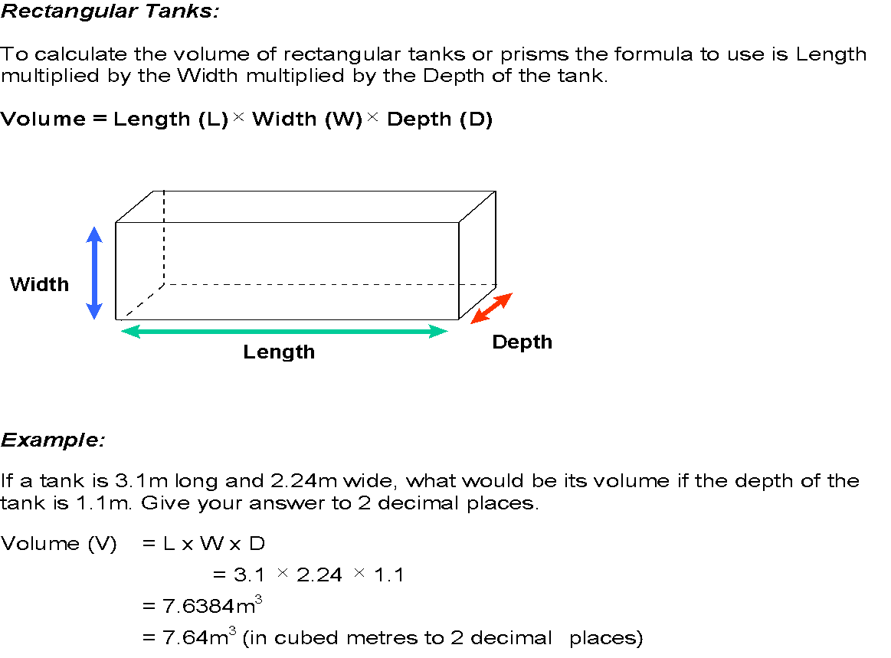

Slide 38
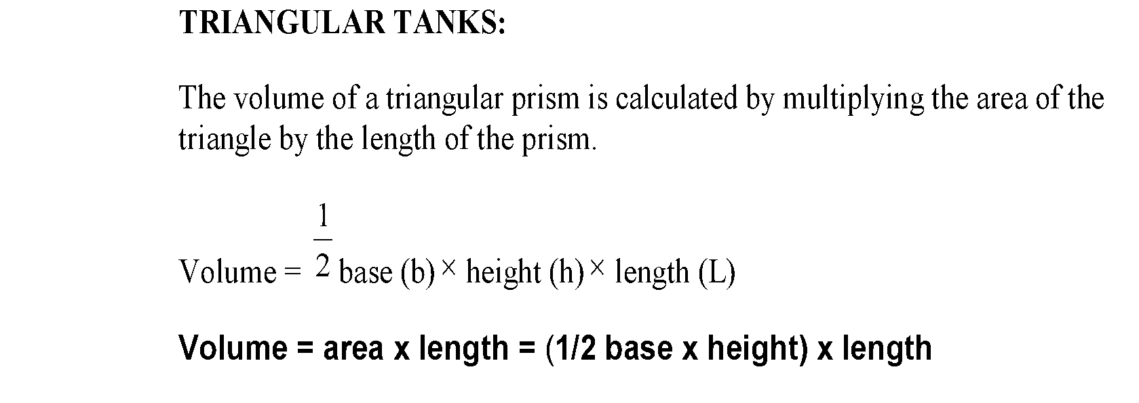
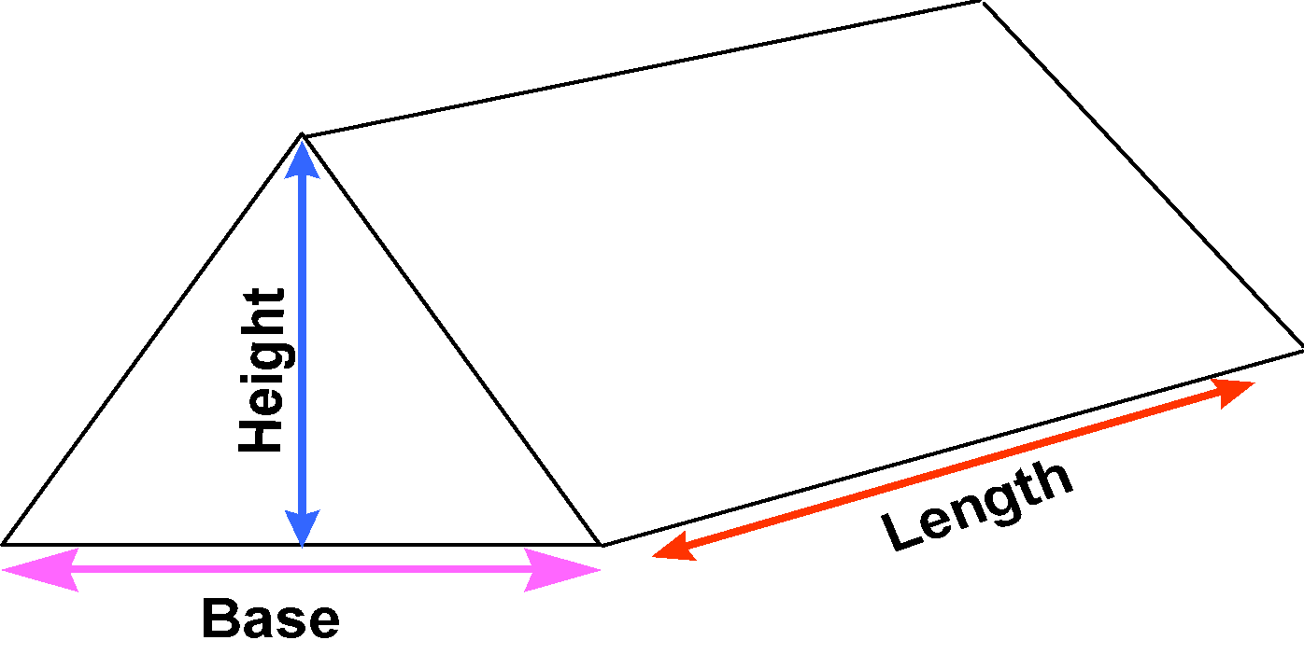

Slide 39
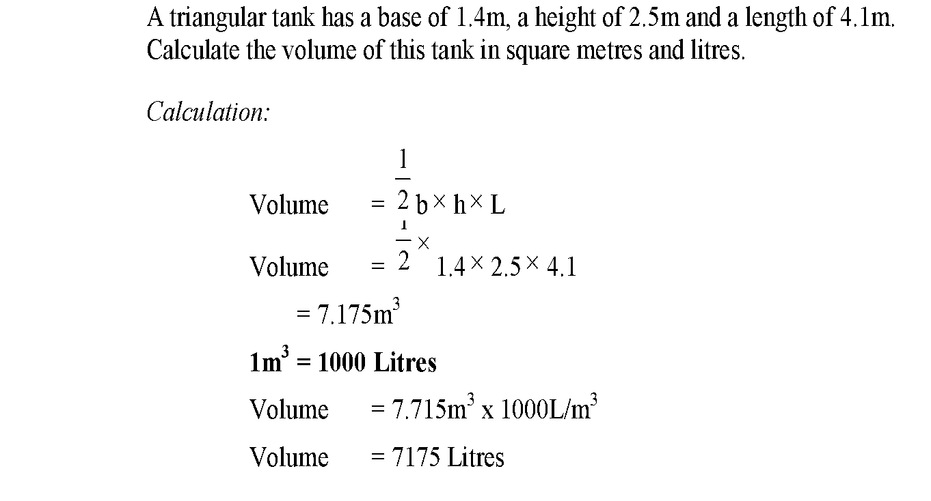
7.175m
What would the volume be if filled to 95 %
What would the weight be if the liquid had a SG of .85

Slide 40
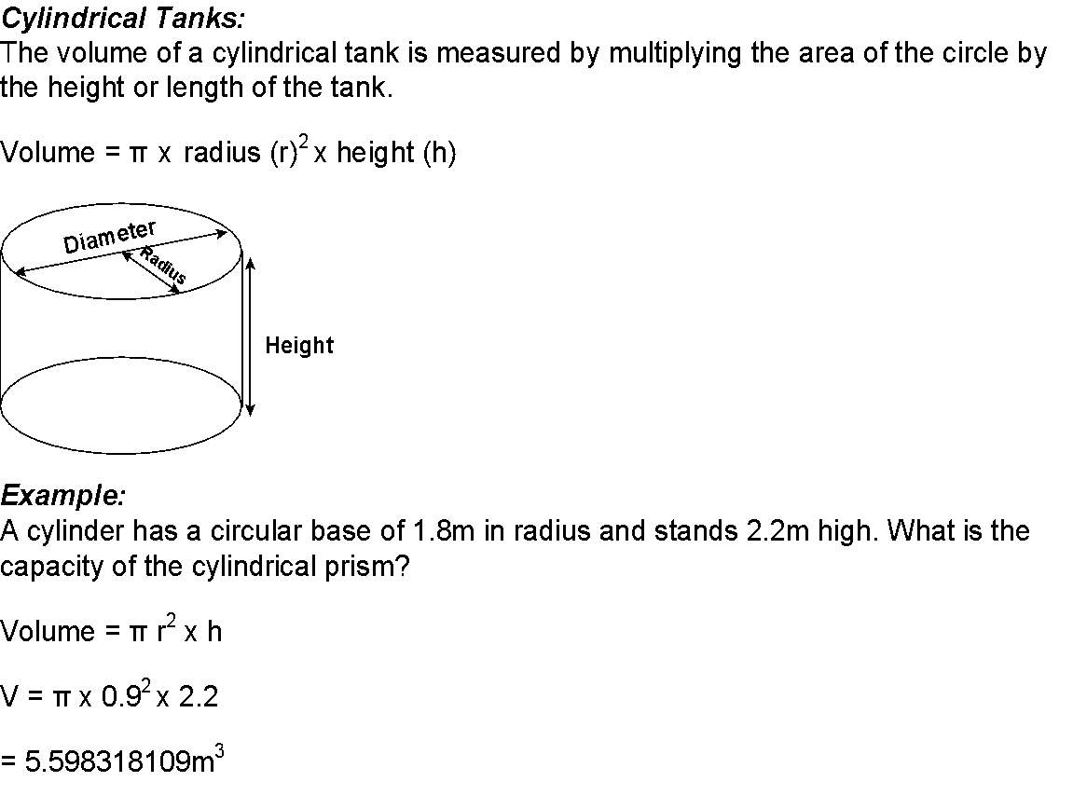
V= 3.142 x ( 1.8 x 1.8) x 2.2
= 22.396 m2

Slide 41
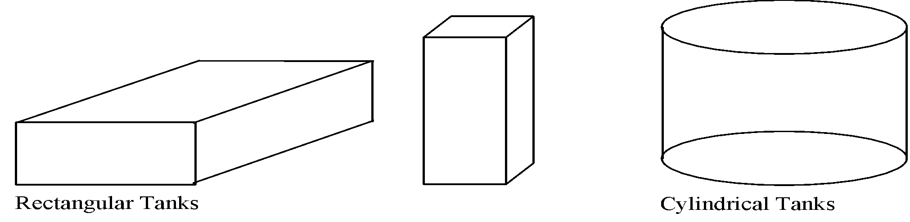
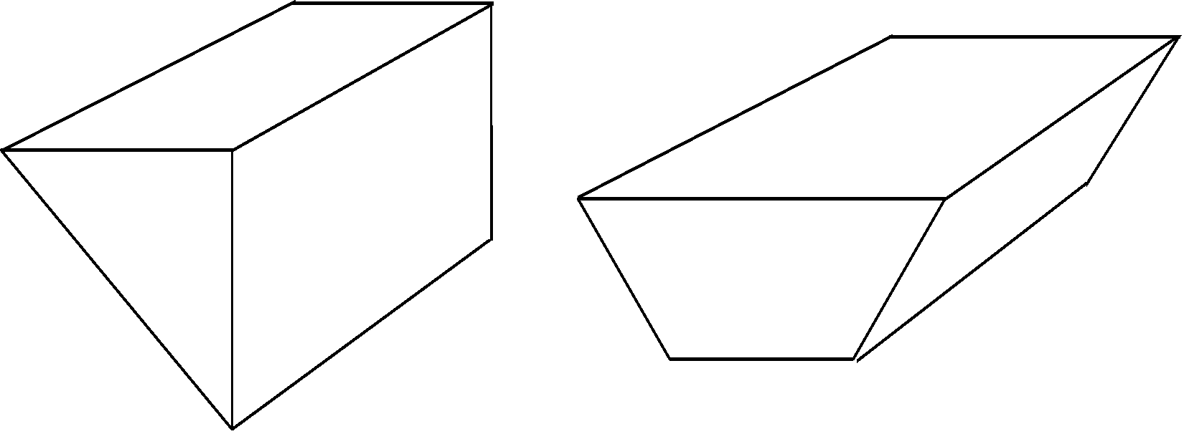
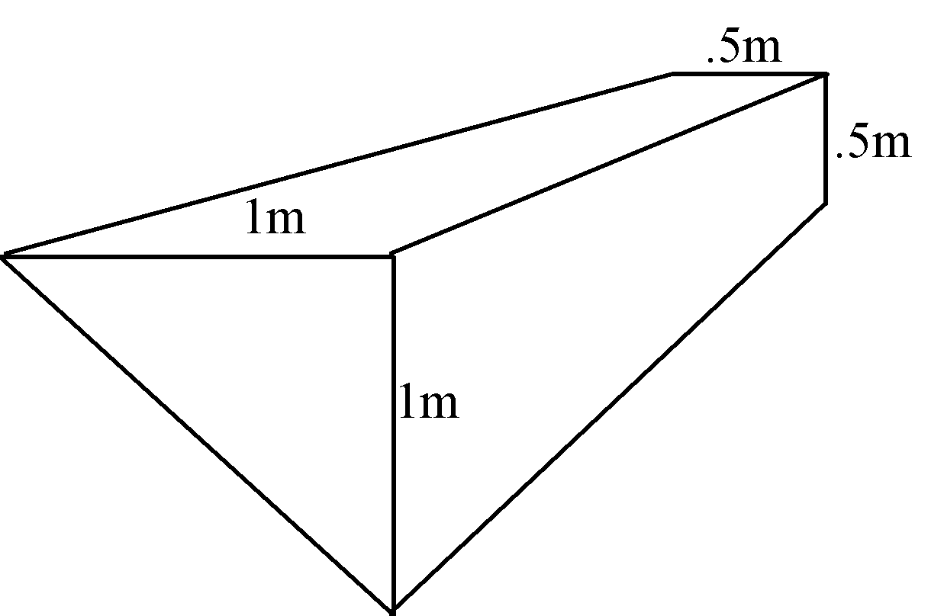
Tank Volumes
VOLUME is the capacity measurement for three dimensional objects, in this case, tanks.
For the purpose of calculations, the following tanks are defined as “regular” or “irregular” in shape:
Triangular Tank Trapezoidal Tank

Slide 42
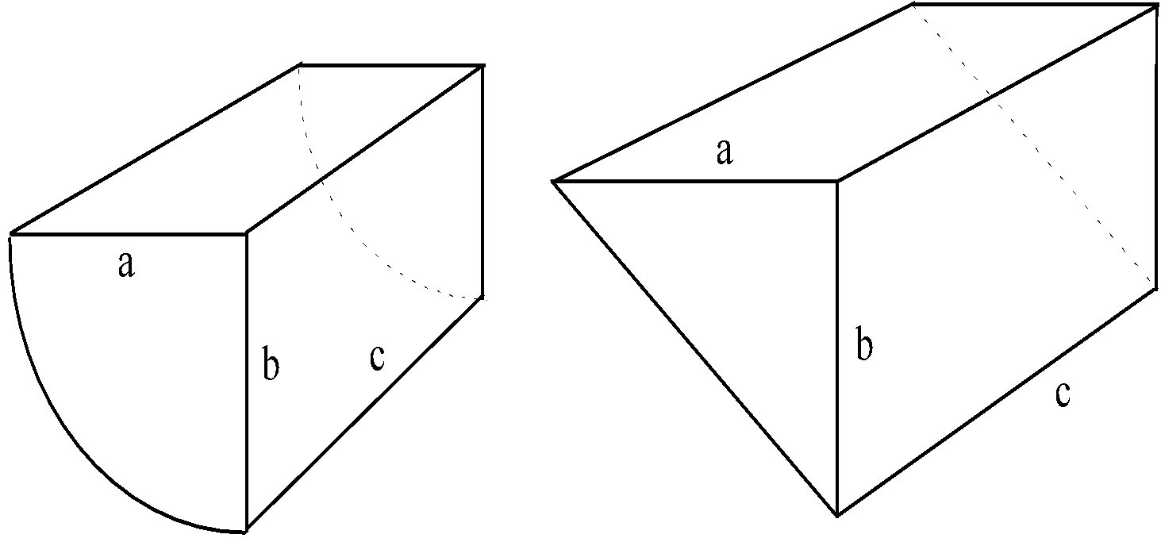
In practical situations you may need to make calculations based on an approximate shape. For example, this curved tank can be approximated either to a triangular tank or a quarter of a cylinder depending on the lengths of a and b and the curvature of the side.

Slide 43
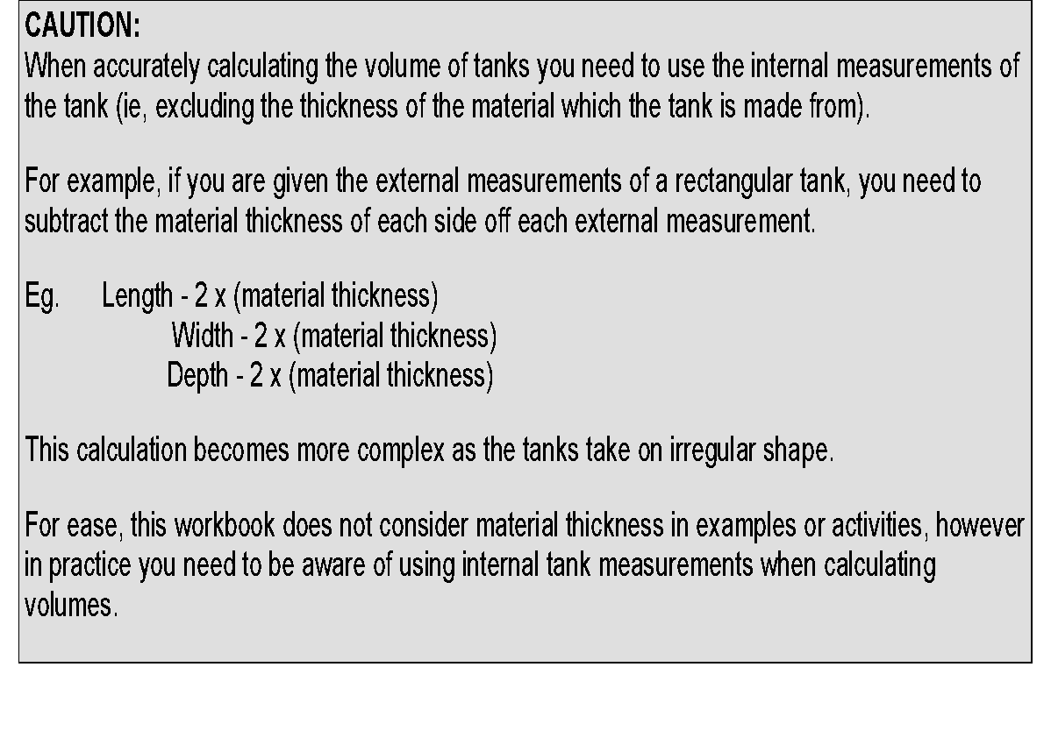
The external measurements of a tank are 1.2 m x1.4m x 1.6 m and the steel is 8mm thick, What is the volume of the tank?

Slide 44
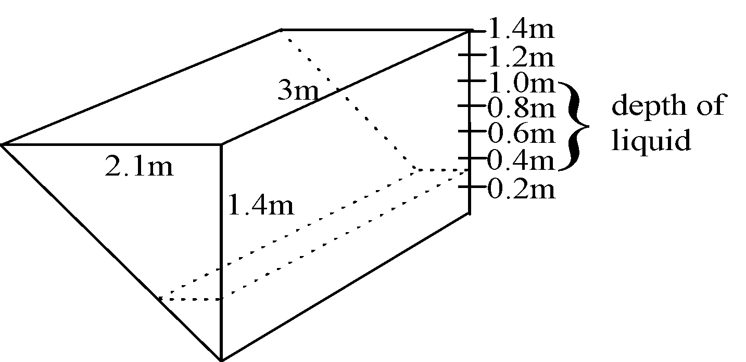
Triangular tanks can be deceptive when calculating liquid quantities. A triangular tank with liquid half way up the side will not be half full. To illustrate this point, complete the following table for the tank shown:
Depth of liquid (m) | Volume of liquid (L)
0.2
0.4
0.6
0.8
1.0
1.2
1.4
To calculate the volume of fuel you have the length and the height all you need is the base. In this case @0.2 = one seventh of the base of 2.1 meters. Or you can calculate by working out the change in base for each 1 or 10 mm of height by converting the height into millimetres or centimetre's and dividing that into the full base width to find the rate of change for the base per mill or cant of height change

Slide 45
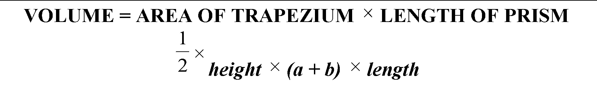
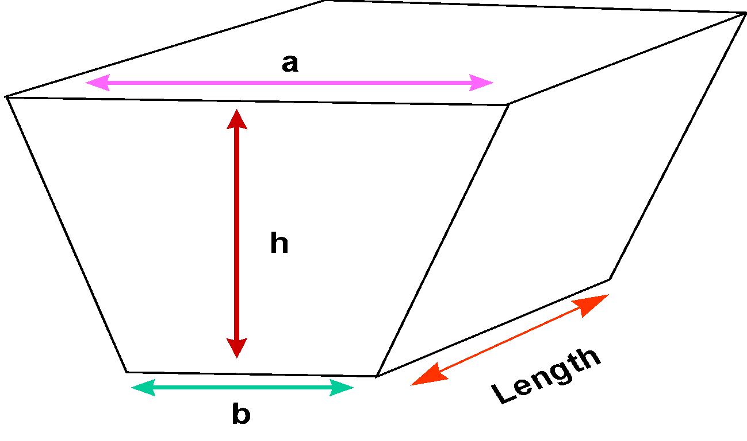
TRAPEZOIDAL TANKS:
The volume of a trapezoidal shaped tank is calculated using the following formula:

Slide 46
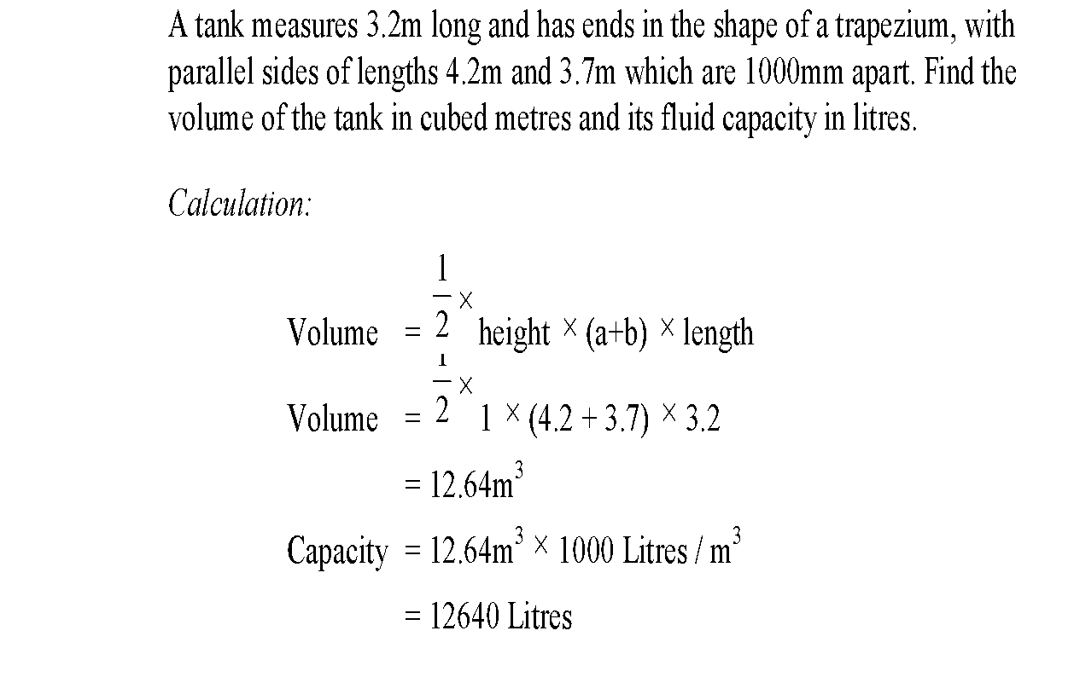
TRAPEZOIDAL TANKS:

Slide 47
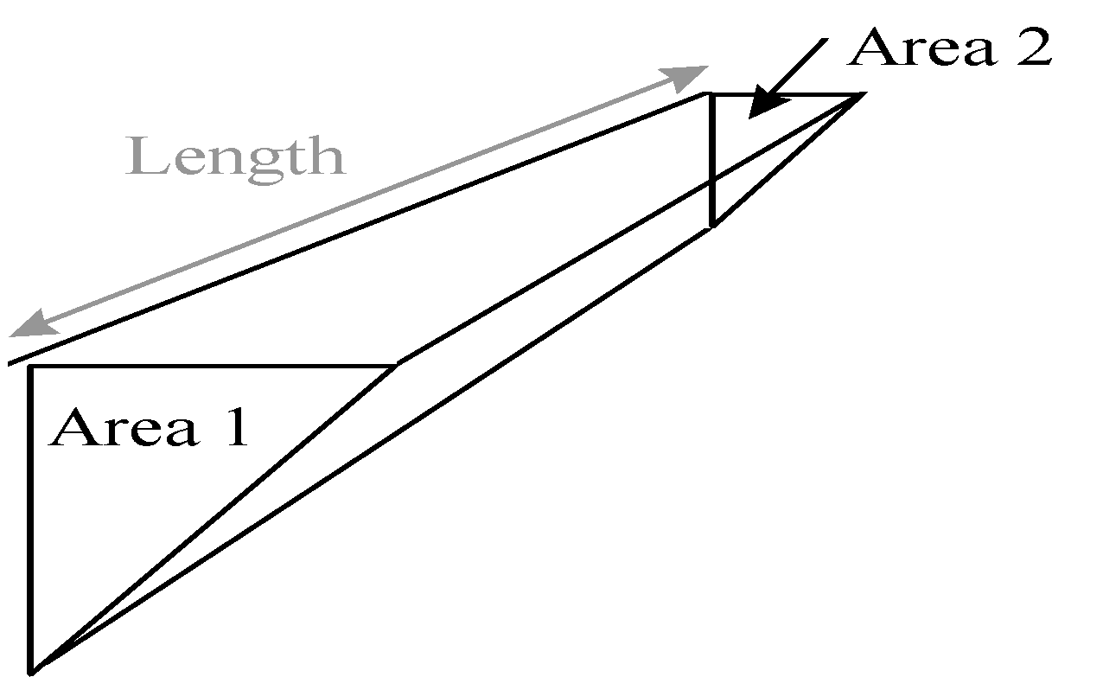
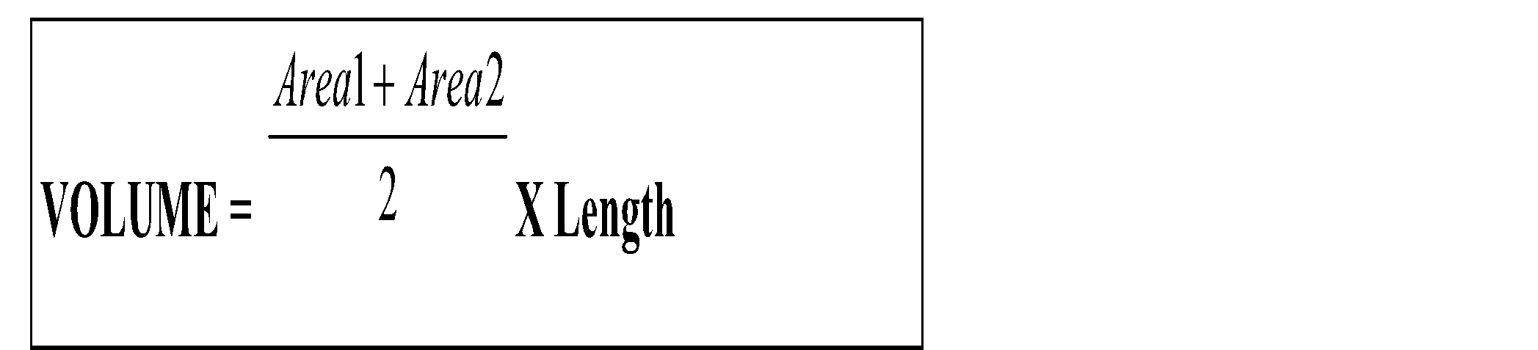
TAPERED TANKS
Some tanks are tapered and require an additional process when calculating the volume:
Where two ends are the same shape (but have different areas due to the tank becoming narrower over its length) calculate the volume in the following

Slide 48
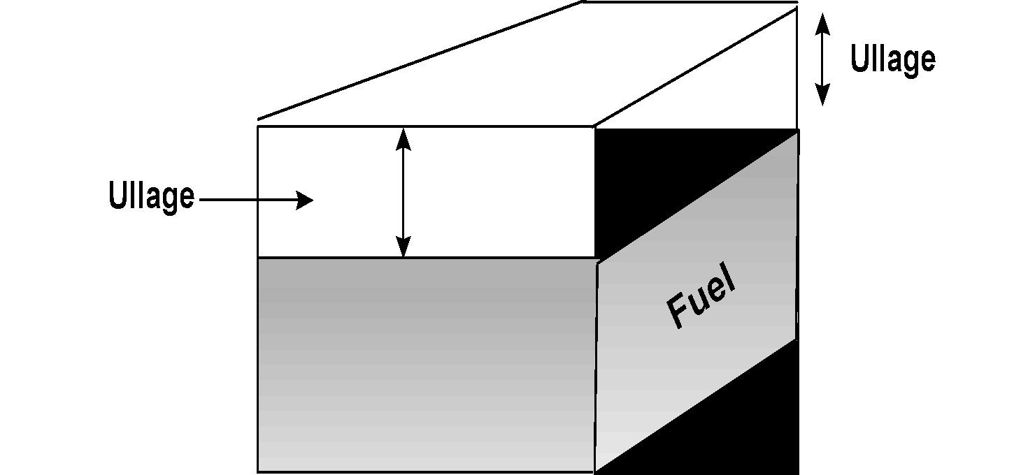
Ullages or Sounding of Fuel
Ullage or sounding of fuel are the amount by which the fuel falls short of filling the tank.

Slide 49
Fuel Calculations
What is the volume of a circular tank of 1.3 meters diameter and a height of 1.3 meters?
2. What is the volume of a tank 1.8 meters by 1.5 meters by 2.35 meters?
3. What is the volume of a triangular tank 1.5 meters base by 1.8 meters high by 2.55 meters long?
4. What is the mass of fuel in each tank filled to 95% with fuel of SG .85?

Slide 50
Fuel Calculations.
If a vessel travels at 6 knots with a single motor burning 12 litres per hour, how much fuel is required to travel 360 nm before allowing for reserves
360 N Miles divided by the 6 knots gives the hours to complete the trip = 60 hours. 60 hours times the 12 litres gives the fuel used = 720 litres for the trip
How far can a vessel travel with 1000 litres of fuel aboard with a single motor burning 19 litres an hour at 20 knots
1000 litres divided by 19 litres gives the hours the fuel will last = 52.63 hours
52.63 Hours times 20 knots per hour = 1052.63 N Miles travelled on the 1000 litres

Slide 51
Fuel Calculations
A circular tank of 1.8 meters diameter and a height of 4.3 meters has 2.7 meters of SG .87 fuel in it.
How much fuel is in the tank?
How much fuel has been used if it was at 95% full when the vessel left port?
If the vessel burns 109 litres per hour how far has it travelled so far?
If fuel consumption increases to 135 litres per hour how far can you steam before there is only 10% of the original volume left?

Slide 52
Calculate amount of fuel used per kilowatt per hour or per Horse power per hour
First you need to find the power you are using @ your current RPM from the engine specification sheet in the engine manufacturers work shop manual.
Then convert the consumption figure of litres per hour into grams per hour.
IE 100 litres per hour of 0.85 SG fuel = 85 kilograms of fuel per hour or 85,000 grams of fuel per hour.
Then divide the KW into the weight of the fuel consumed .
IE, 85 KW divided into 85,000 grams = 1000 grams per KW per hour
Now take the revolutions per minute of the engine say 1000 rpm and turn that into revolutions per hour and divide that into the grams per KW per hour = 1000 divided by 60000 RPH = 0.016 grams per revolution per Kilowatt
This could then be calculated further to check the accuracy of the fuel injector pump against manufacturers specifications to see how the pump is performing and how good the engine is, it will give a reasonable appraisal of engine overall condition and operating efficiency compared to a new engine

Slide 53
In Summary we Have looked at
Refuelling precautions
Tank and system requirements
Tank arrangements
Types and sources of pollution
Required Documents
Reporting Spills
Penalties
Any Questions?

